Slide 1
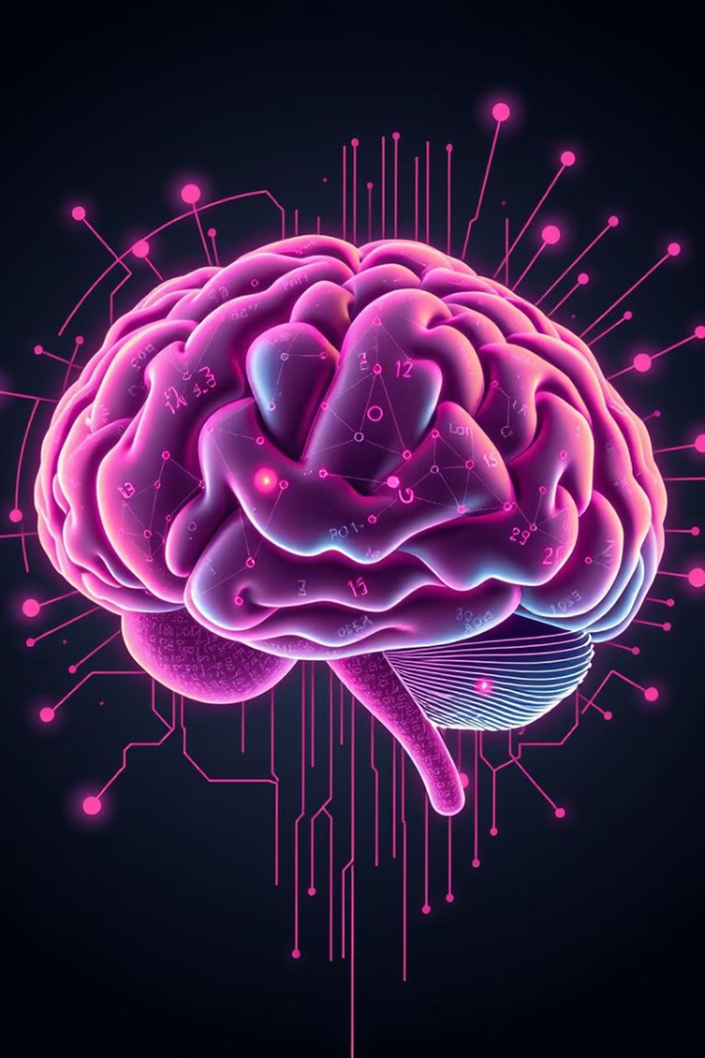
Natural Language Processing
Presented by: KUMARI NISHA

Slide 2
Natural Language Processing
. Definition: NLP is a field of Artificial Intelligence that focuses on the interaction between computers and human languages.
Goal: Enable computers to understand, interpret, and generate human language effectively.

Slide 3
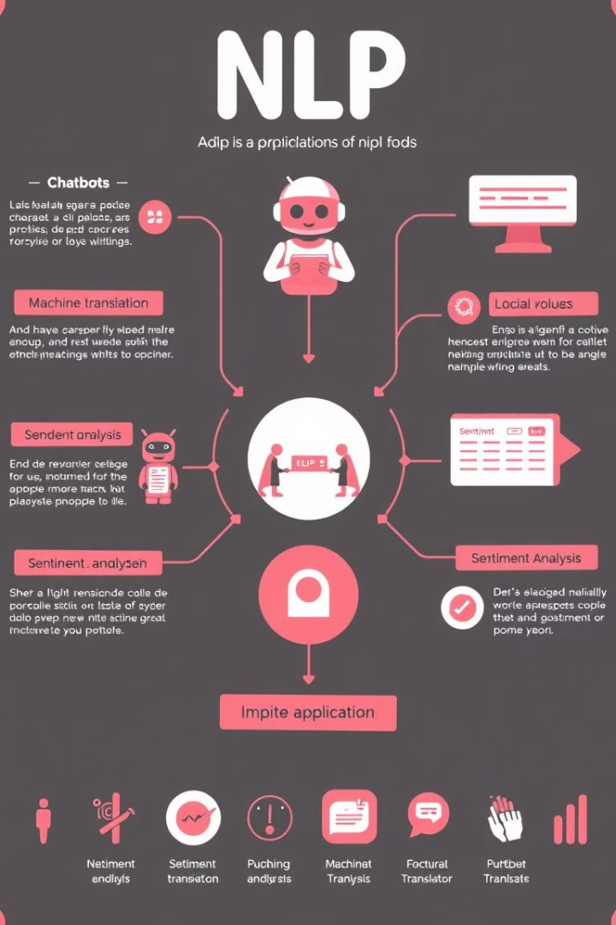
Applications of NLP
Text Analysis: Sentiment analysis, topic modeling.
Machine Translation: Google Translate, DeepL.
Chatbots and Virtual Assistants: Siri, Alexa, ChatGPT.
Speech Recognition: Automated transcription services.
Information Retrieval: Search engines and recommendation systems

Slide 4
Key Components of NLP
Tokenization: Breaking text into smaller units (words, sentences).
Part-of-Speech Tagging: Identifying the grammatical role of words.
Named Entity Recognition (NER): Extracting names, dates, and locations.
Parsing: Understanding sentence structure.
Semantic Analysis: Understanding meaning and context

Slide 5
Techniques in NLP
Rule-Based Methods: Predefined linguistic rules.
Statistical Methods: Machine learning models trained on large datasets.
Deep Learning: Use of neural networks like RNNs and Transformers (e.g., BERT, GPT).

Slide 6
NLP Tools and Libraries
NLTK: Natural Language Toolkit for basic NLP tasks.
SpaCy: Industrial-strength NLP library.
Hugging Face Transformers: Pre-trained models for tasks like translation and summarization.
Gensim: Topic modeling and document similarity analysis.

Slide 7
Challenges in NLP
Ambiguity: Words or sentences with multiple meanings.
Context Understanding: Capturing implied meanings and cultural nuances.
Data Requirements: Large datasets needed for training models.
Bias: Ensuring fairness and neutrality in AI outputs.

Slide 8
NLP in Action
Example 1:
Sentiment Analysis “The movie was absolutely amazing!” → Positive Sentiment
Example 2: Machine Translation “Hola, ¿Cómo estás?” → “Hello, how are you?”

Slide 9
Conclusion:
NLP is revolutionizing the way humans interact with machines.
Continued advancements will make AI more accessible and intuitive.
Challenges like ambiguity and bias need ongoing research and ethical considerations.

Slide 10
THANK YOU

